Slide 1
Spectra of the Moon using a Robotic Telescope
E.Almas, T.Christoffersen, W.Hogg, E.Stone

Slide 2
Goals: the following steps (1-5) are mandatory in order to complete the project, however you may boost marks, either as a group, or as an individual, with optional goals (5-8).
(1)Demonstrate acquiring calibrated test spectra of different materials .g. tarmac, concrete, rock samples, vegetation, using a hand held spectrometer.
(2)Use N (e.g. 20) identifiable reference areas of the Moon (highland and/or mare) to calibrate measured brightness values in the CCD camera wrt a standard lunar pectrum(find this on-line).
(3)select and measure some target areas that you want to measure the spectrum of wrt the previously derived standard lunar spectra.
(4)Analyse the spectra from (3) to determine –can you see any mineral absorption ands –what might these be? What is/are the most colourful area(s)f the Moon?
(5)How accurately can you measure absorption bands in the spectra of lunar surface features you are studying(use propagation of errors)?
(6)Investigate whether the telescope optics suffer from vignetting, or other non-linear sensitivity effects, across the image. Can you calibrate out/mitigate this effect if present?
(7)Experiment with producing meaningful co-registered colour ratio images of the lunar surface o highlight surface composition differences.
(8)Repeat your spectra measurements at other lunar phases to see if the surface changes colour at different illumination and viewing angles?

Slide 3
Spectra of objects with handheld spectrometer

Slide 4
Calibrating the Spectrometer
“Before analysing a sample it is frequently necessary to check the calibration of the spectrometer that is being used. This is performed by analysing known samples and measuring the error between the empirical and known values for the samples. A skew, or bias, can be introduced into the data handling routines of the data analysis equipment of the spectrometer to compensate for these differences.”
Davies, Anthony MC, and Harald A. Martens. "Method and apparatus for calibrating a spectrometer." U.S. Patent No. 5,321,970. 21 Jun. 1994.

Slide 5
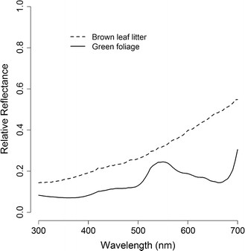
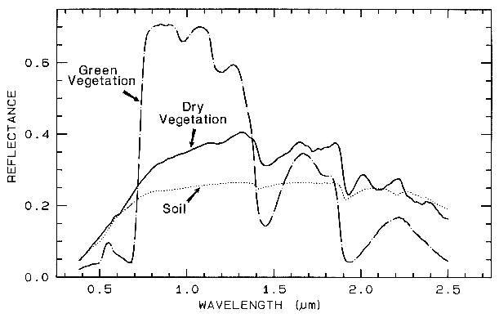
Comparing to Known spectra
Figure 1: Mean reflectance spectra of brown leaf litter (n = 20) and... - Scientific Figure on ResearchGate. Available from: https://www.researchgate.net/figure/276212092_fig6_Figure-1-Mean-reflectance-spectra-of-brown-leaf-litter-n-20-and-green-foliage-n [accessed Feb 19, 2016]
http://speclab.cr.usgs.gov/PAPERS.refl-mrs/refl4.html#section4.3

Slide 6
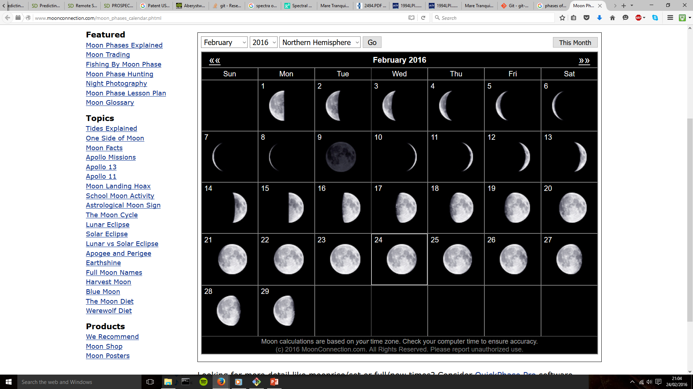
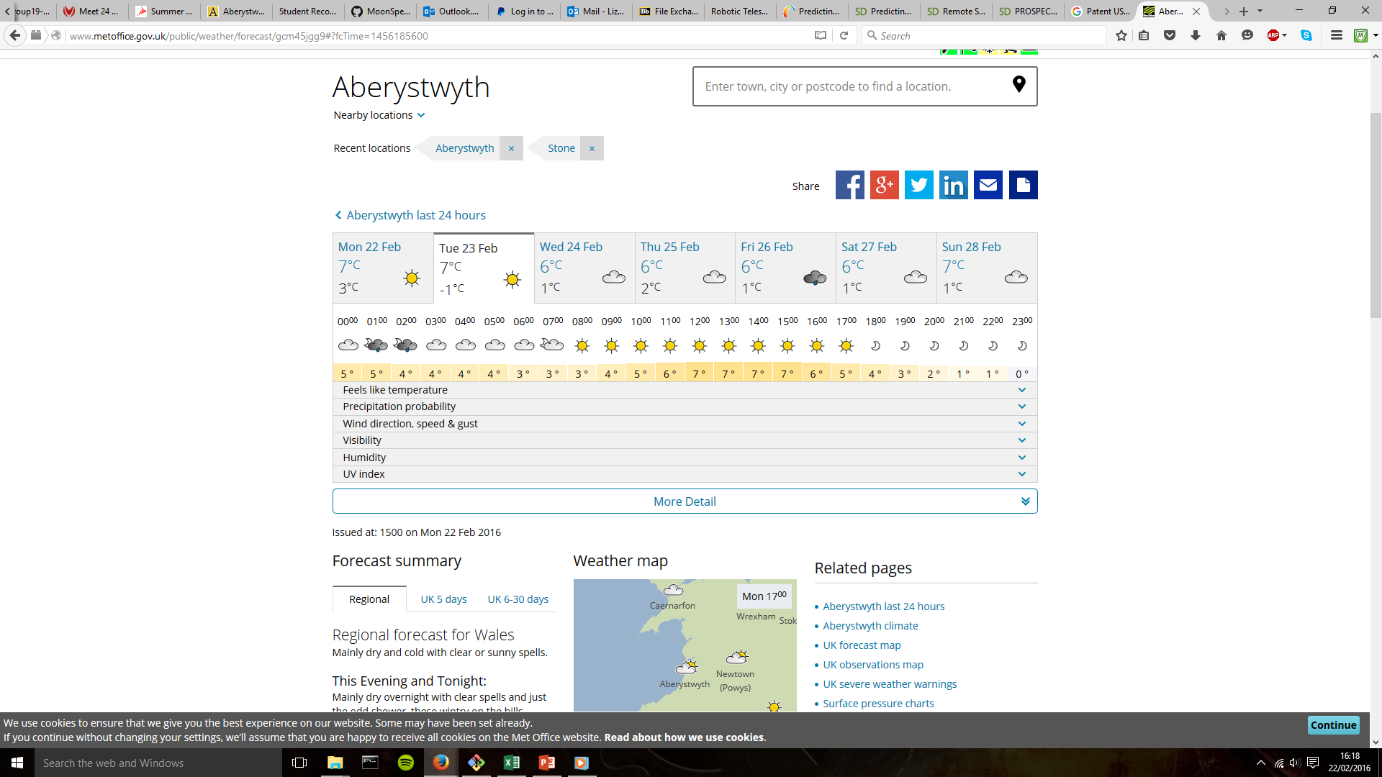
Planning with the weather and lunar-tables
http://www.metoffice.gov.uk/public/weather/forecast/gcm45jgg9#?fcTime=1456185600
http://www.moonconnection.com/moon_phases_calendar.phtml

Slide 7
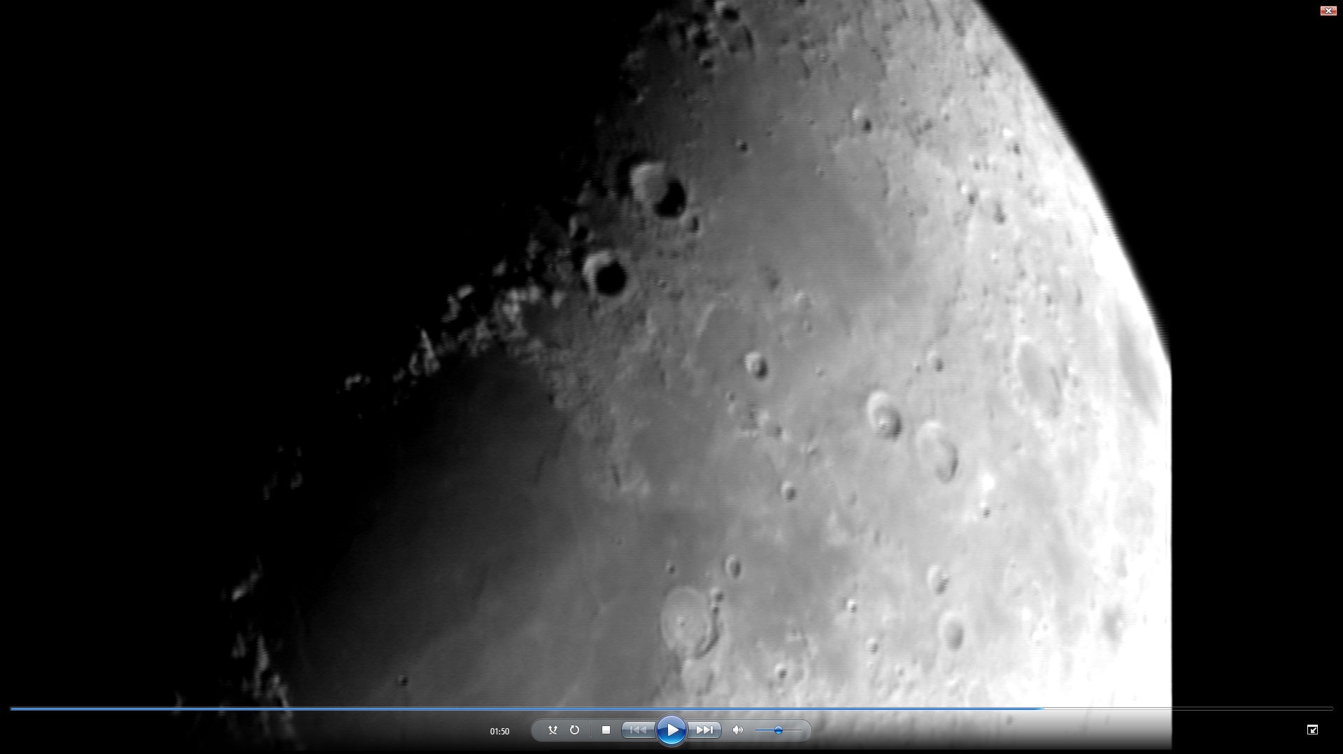
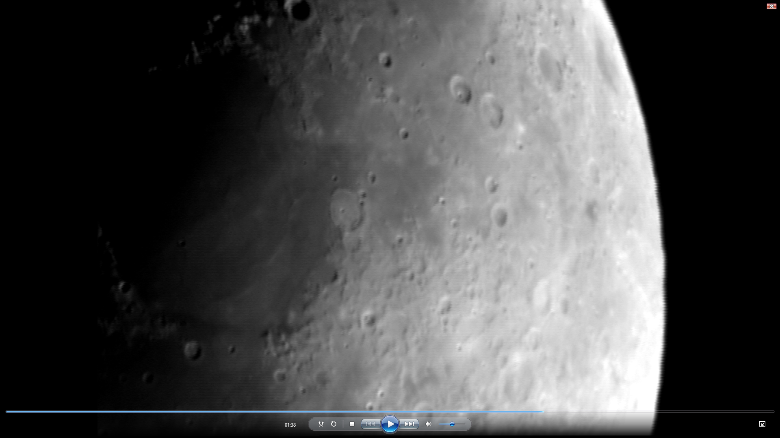
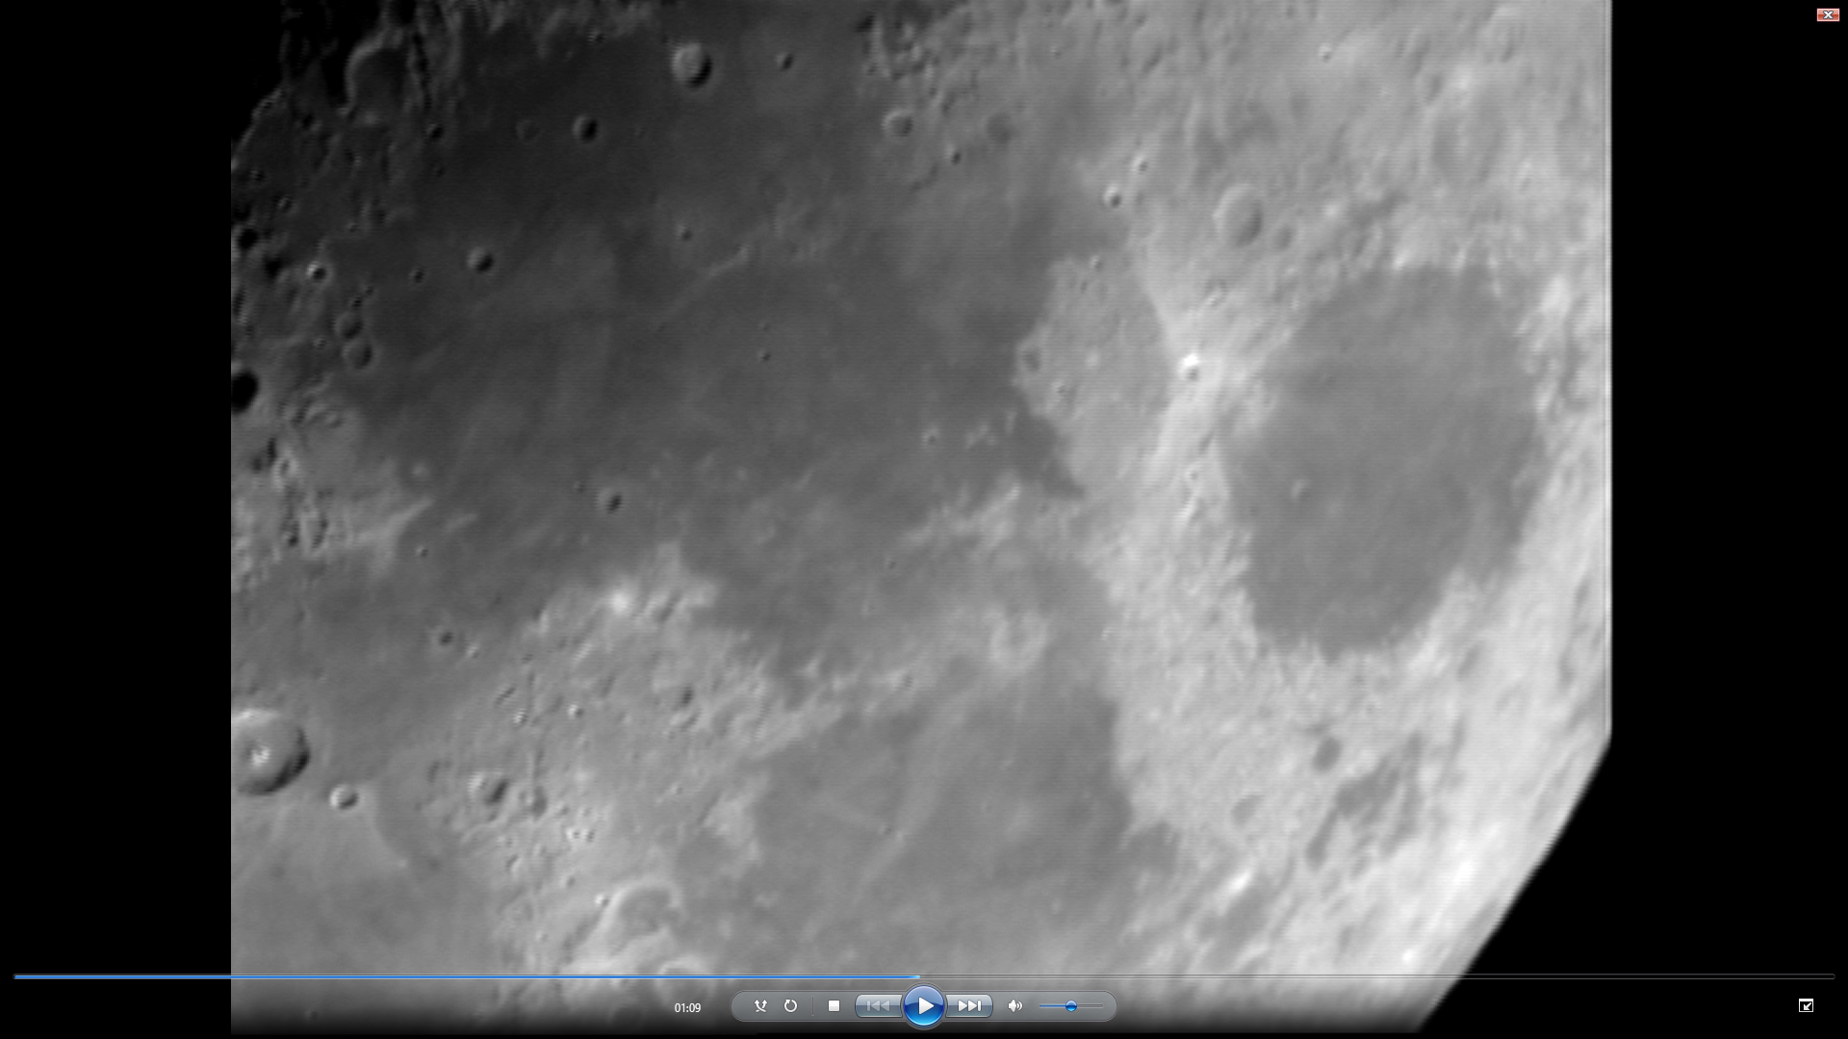
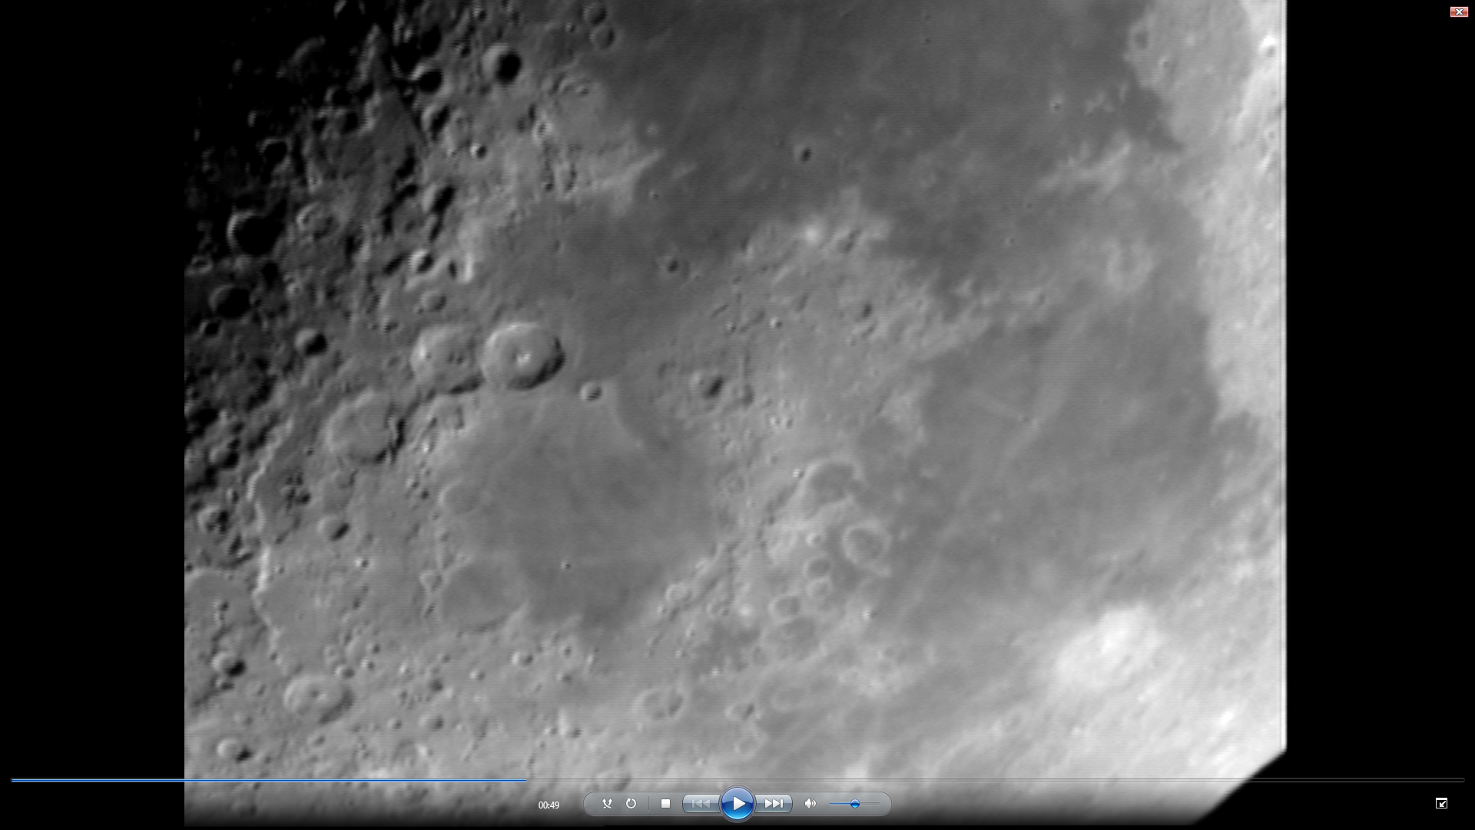
Taking our own images

Slide 8
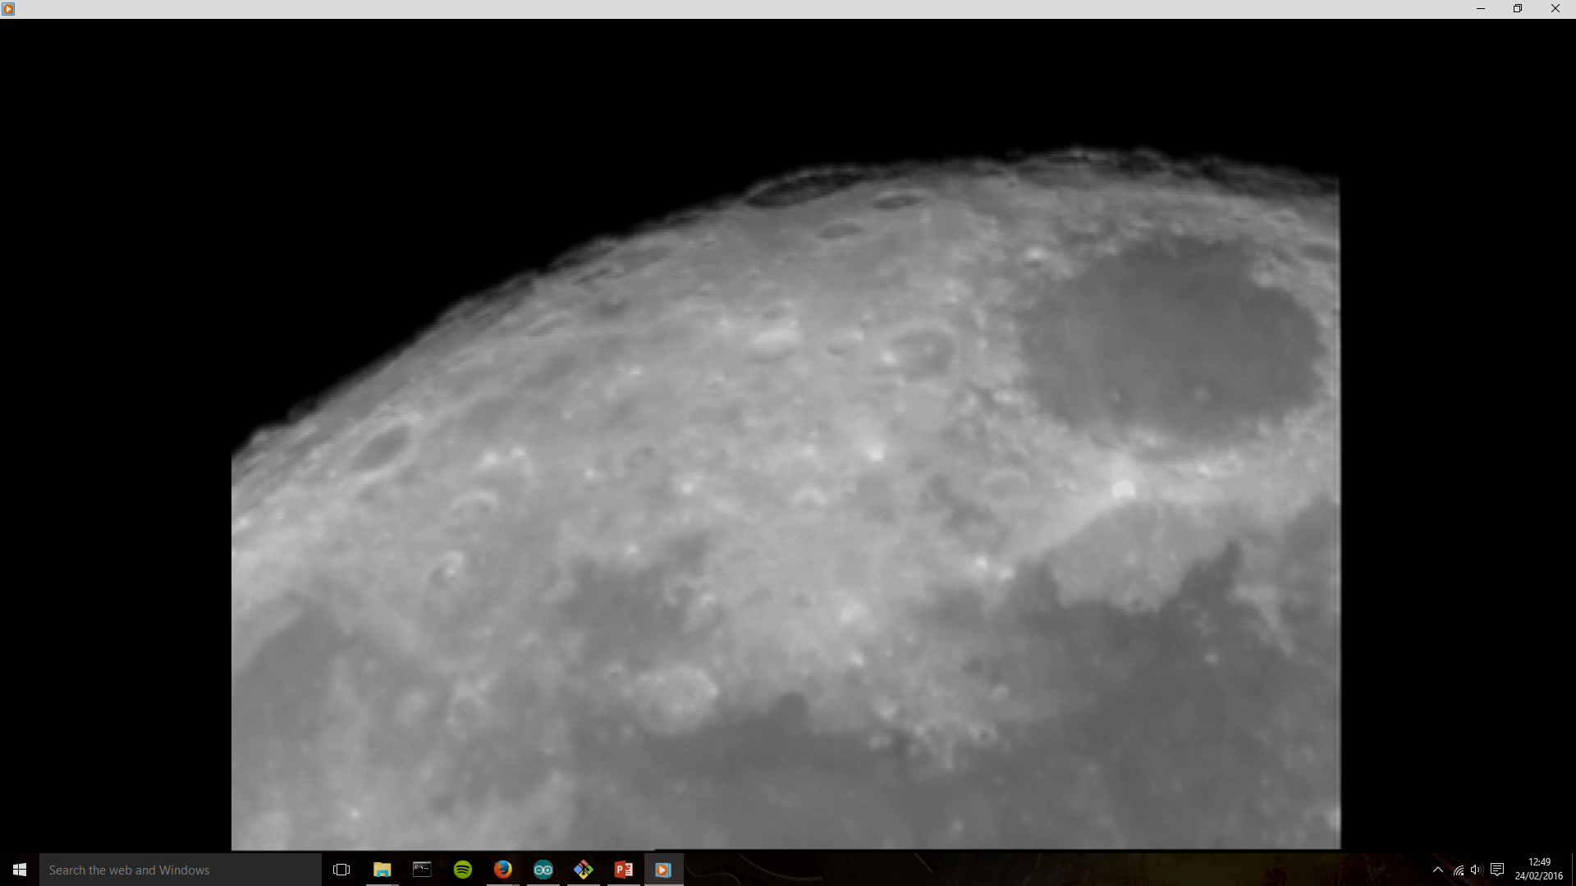
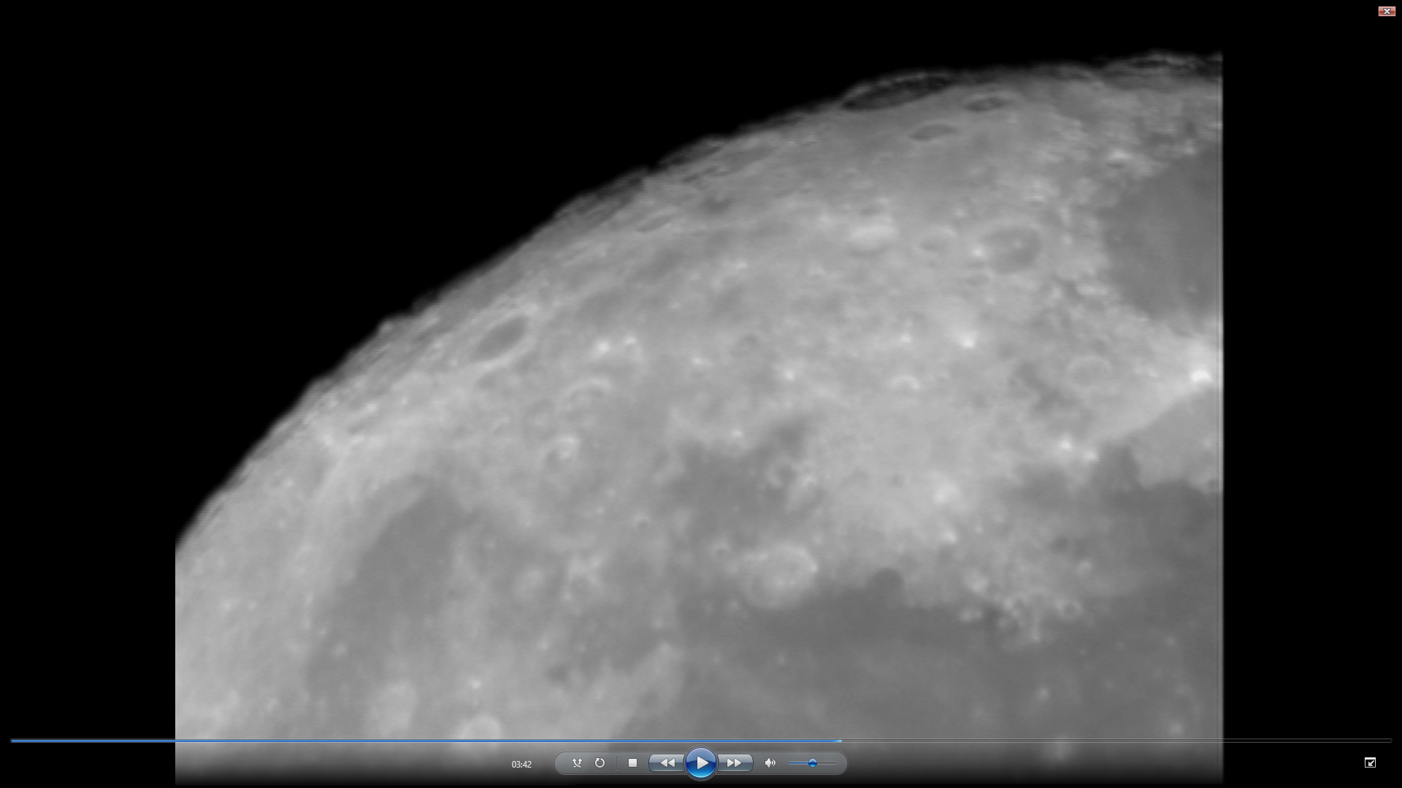
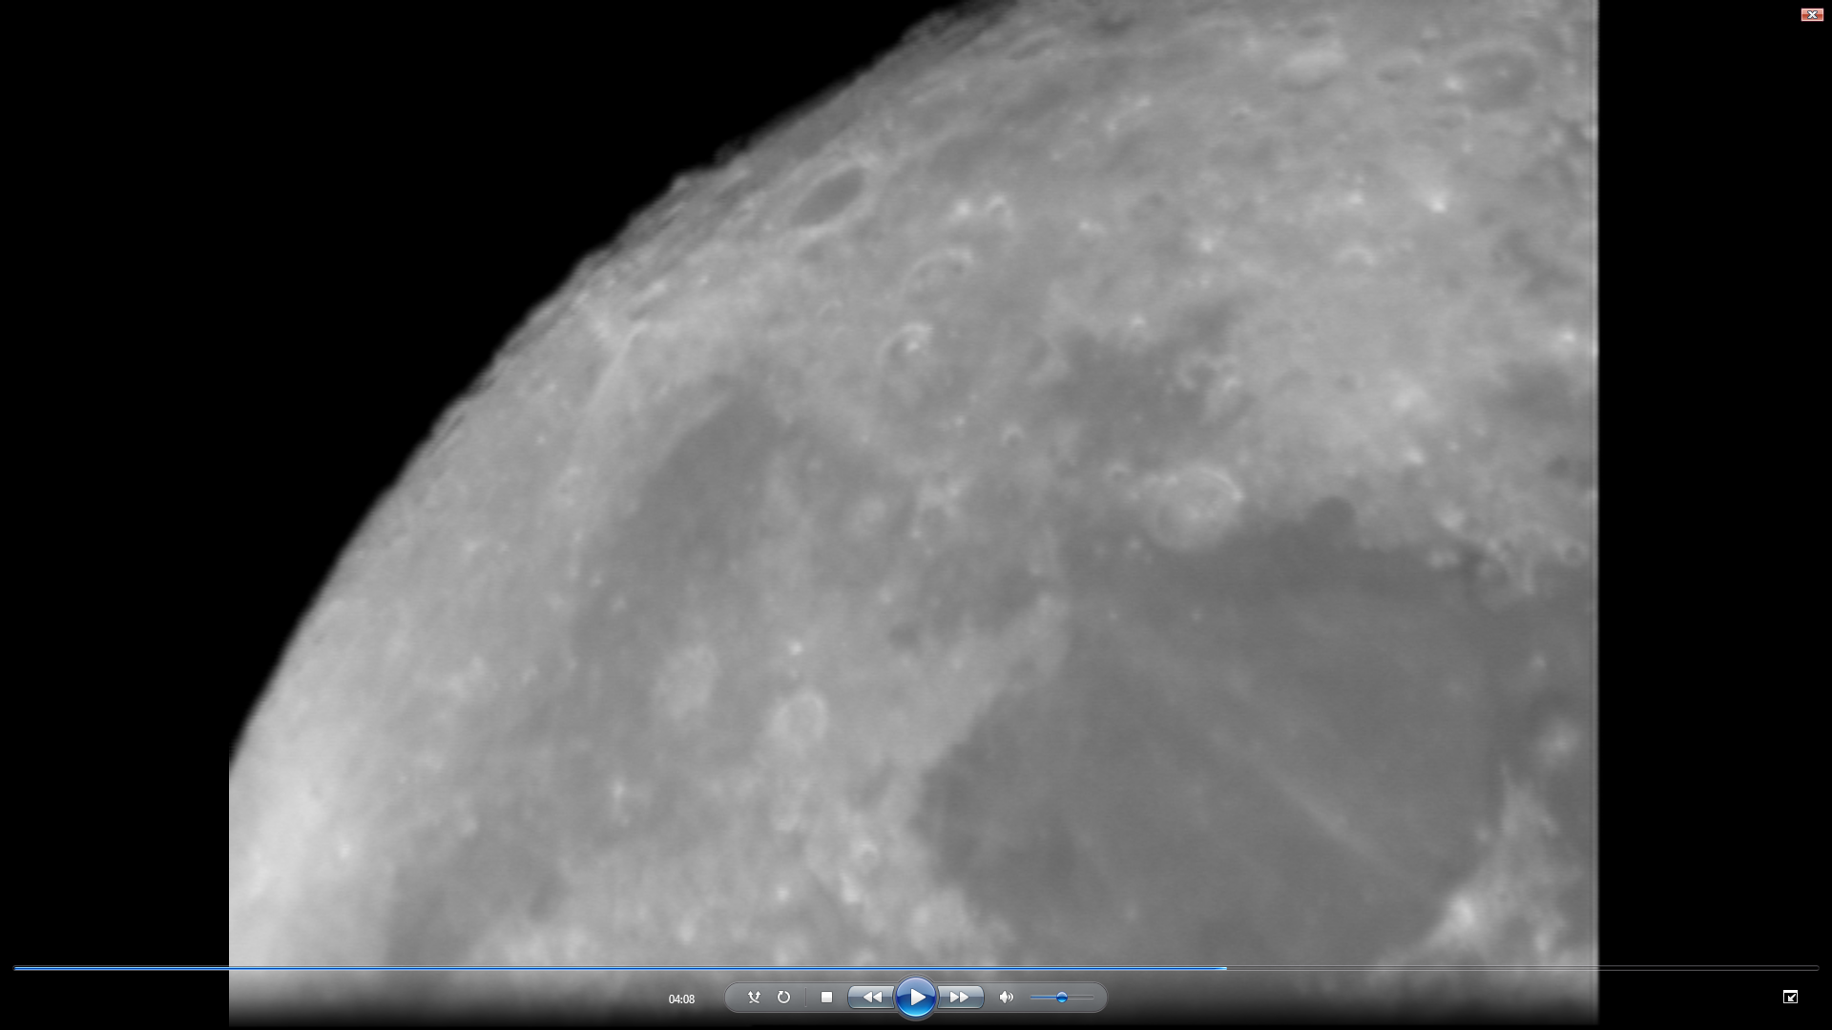
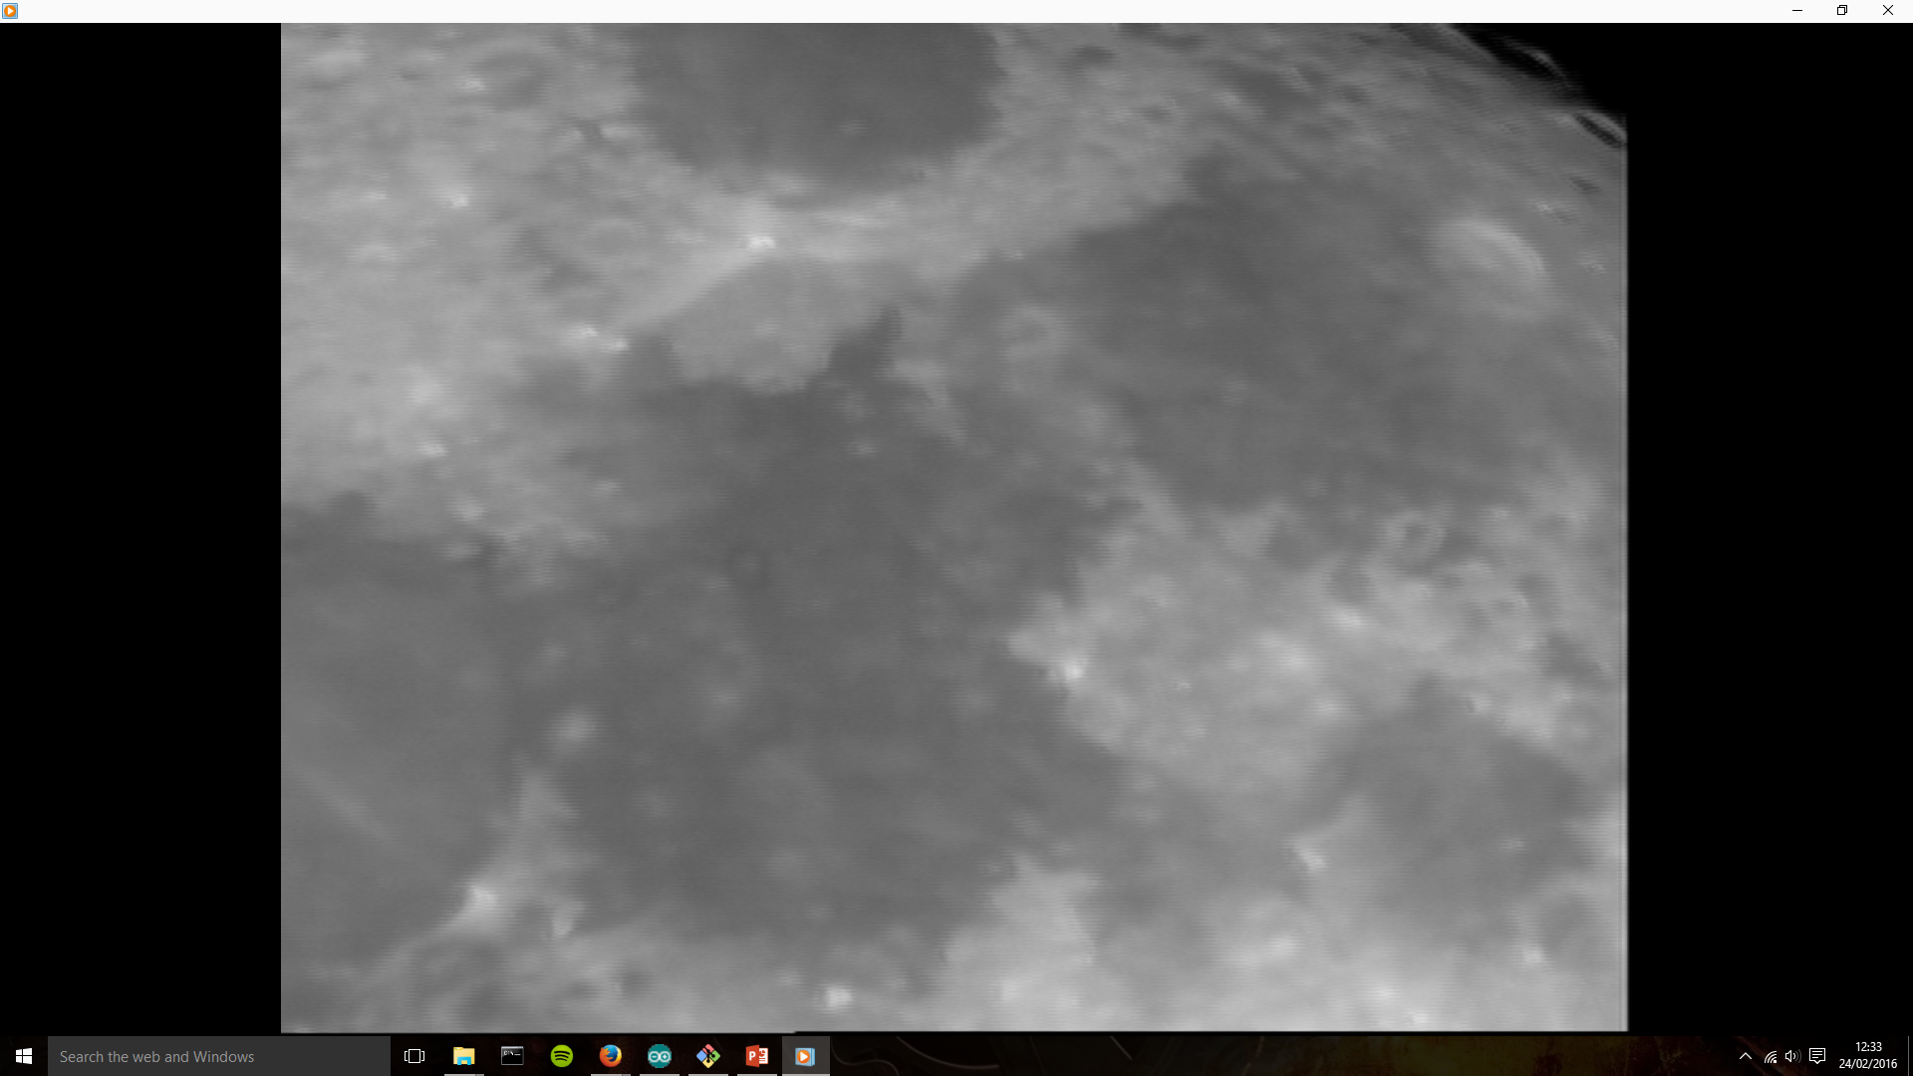
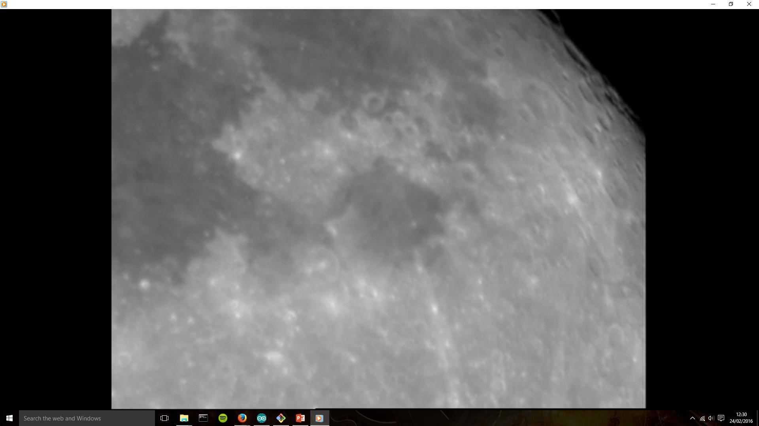
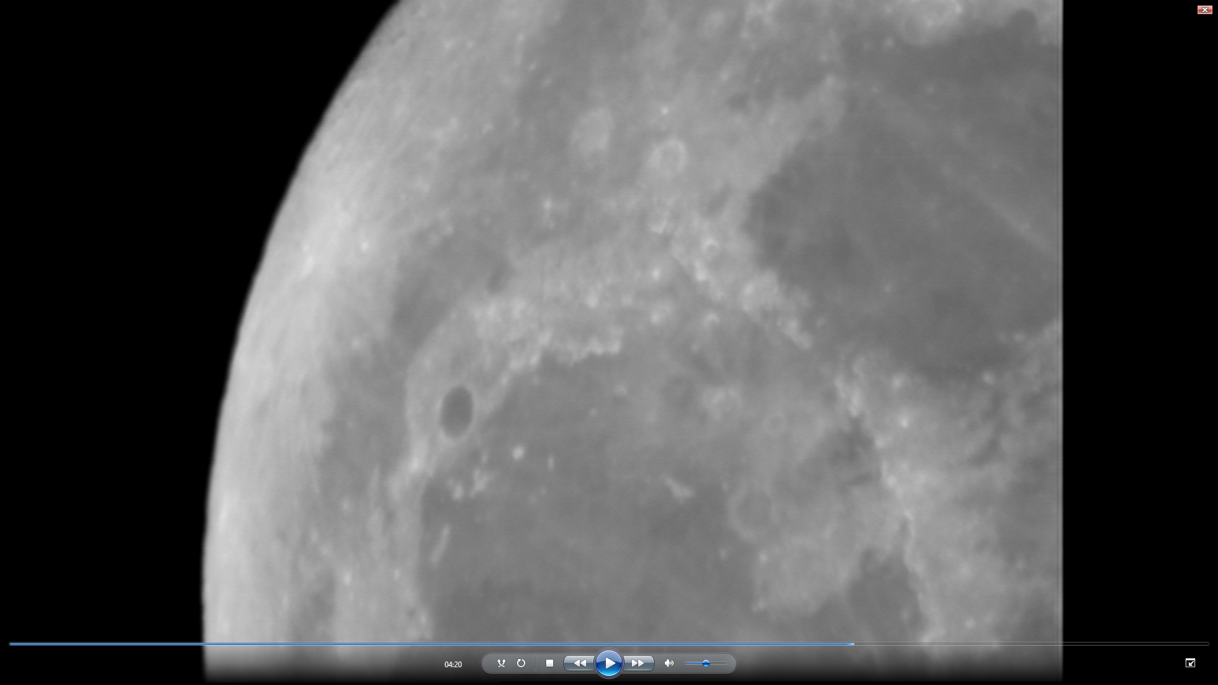
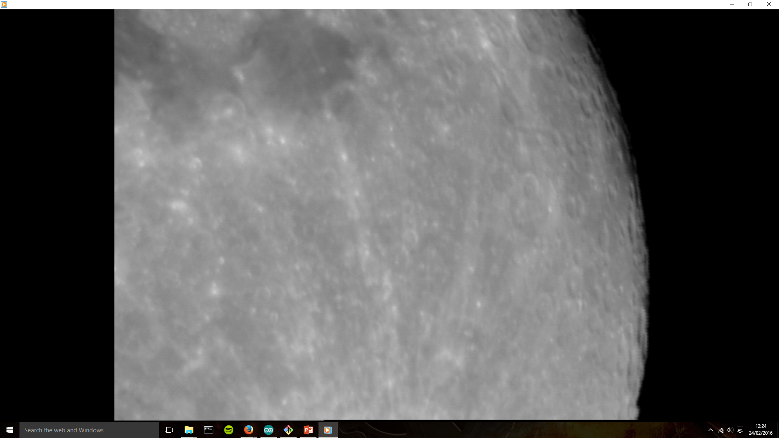
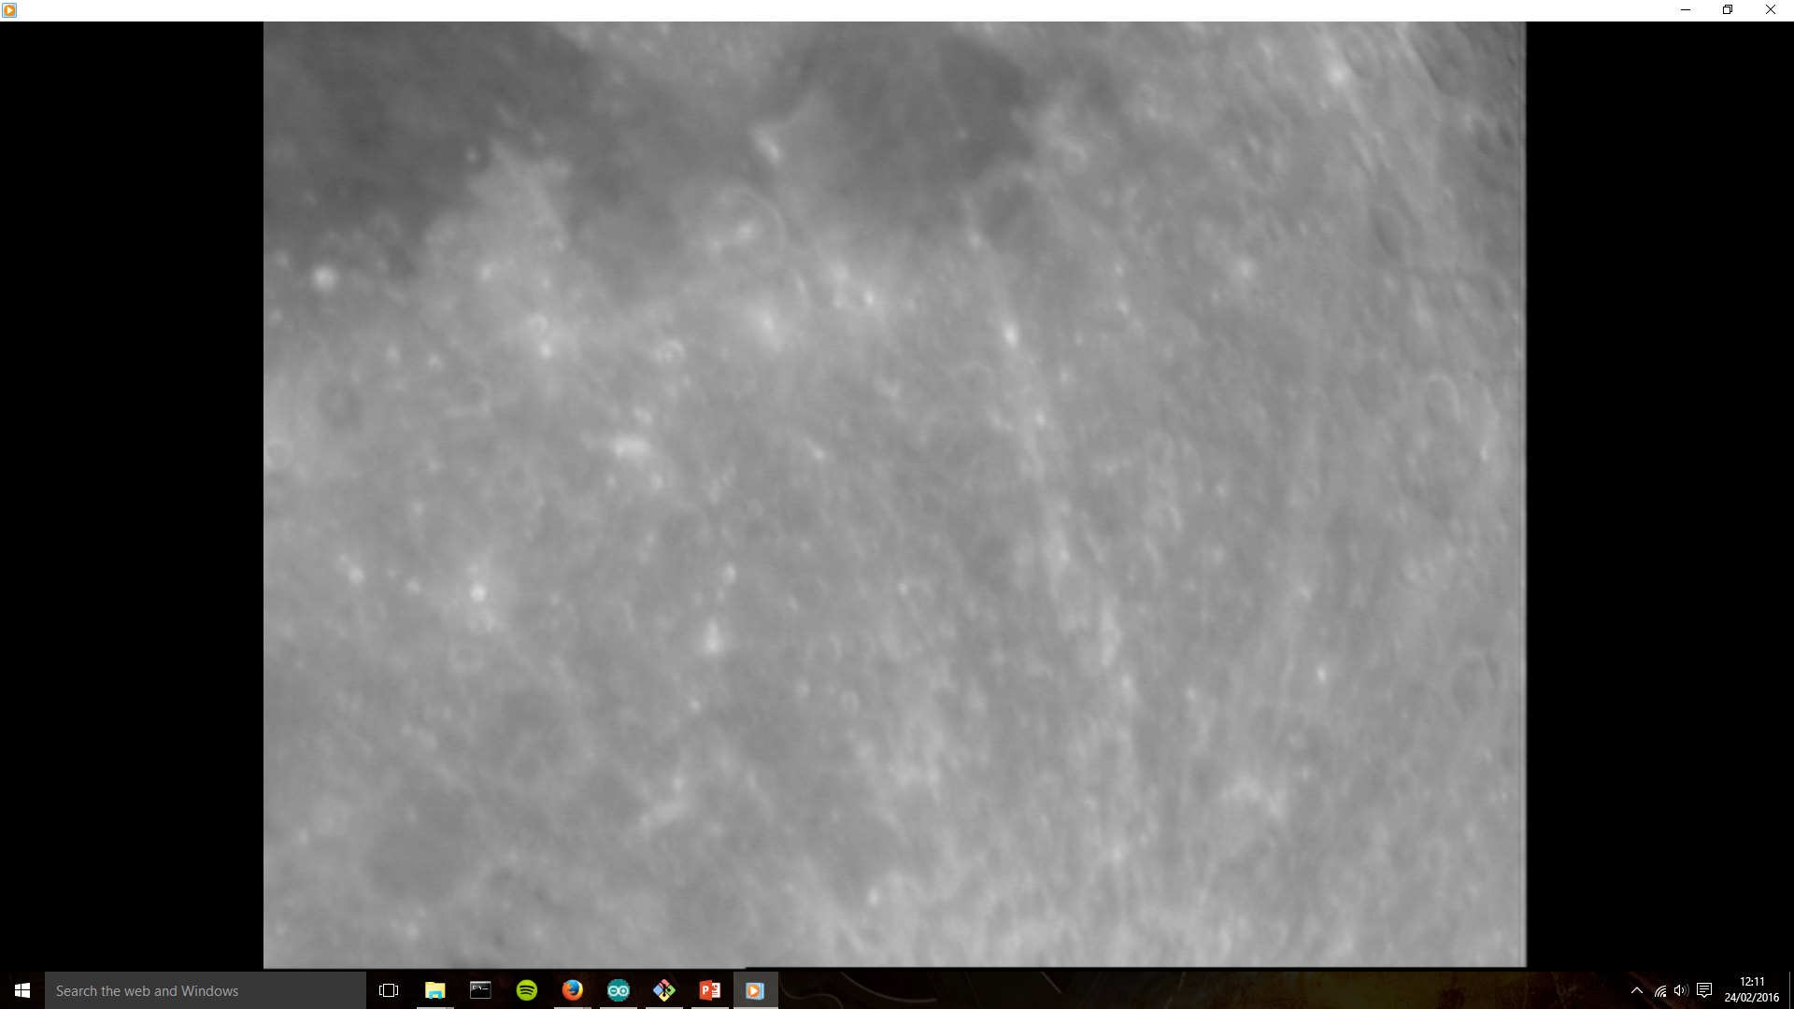
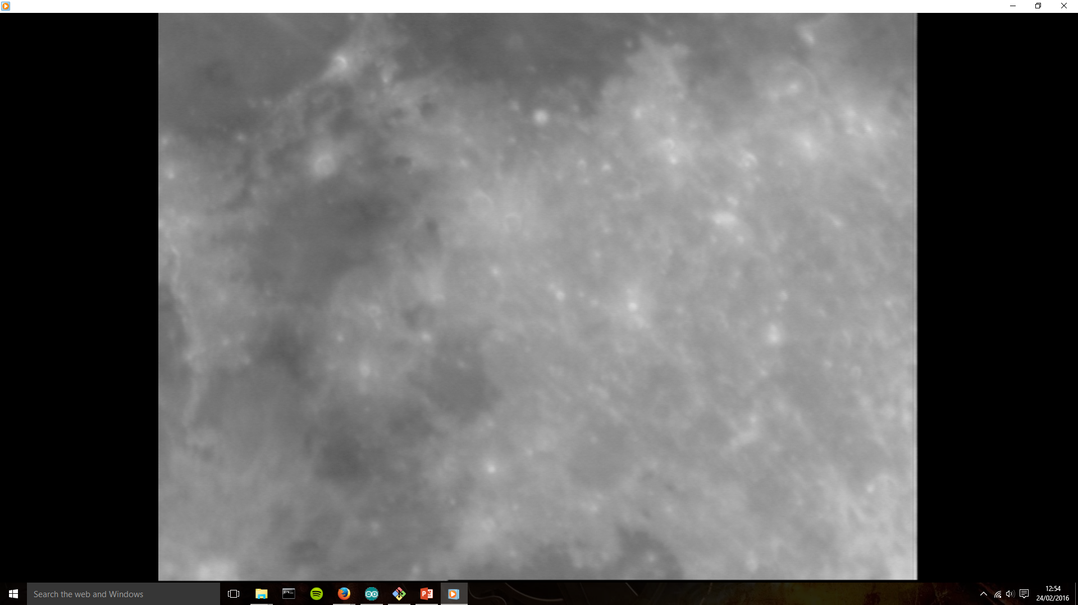
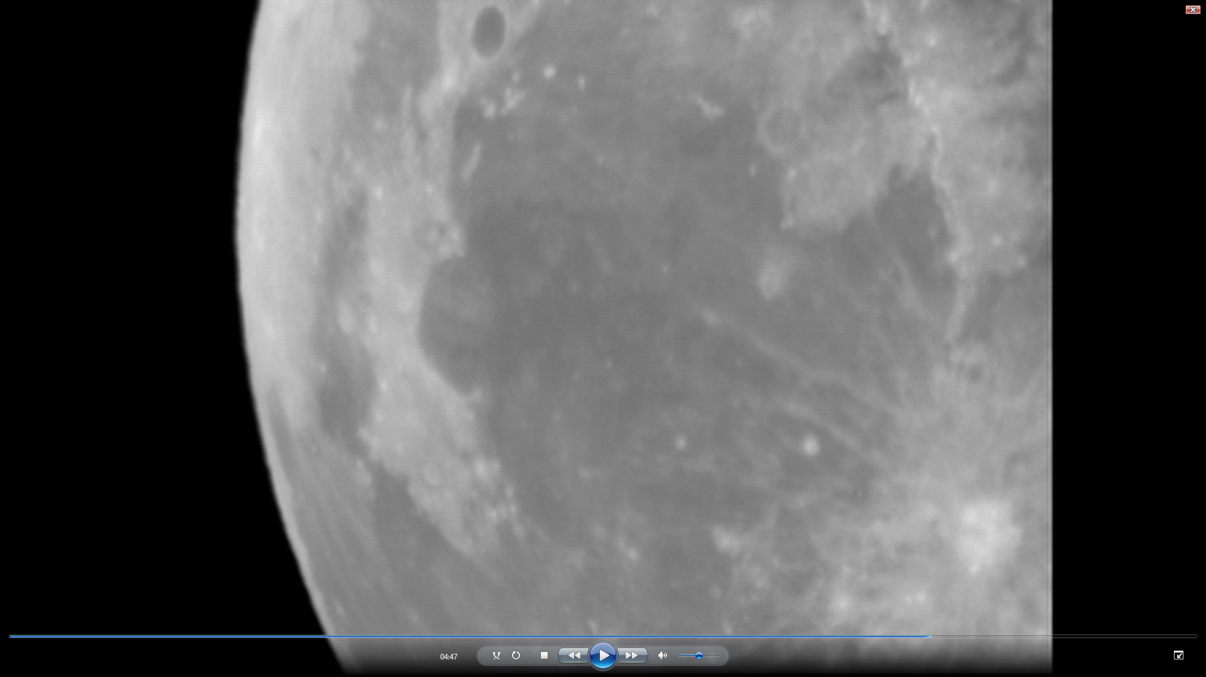
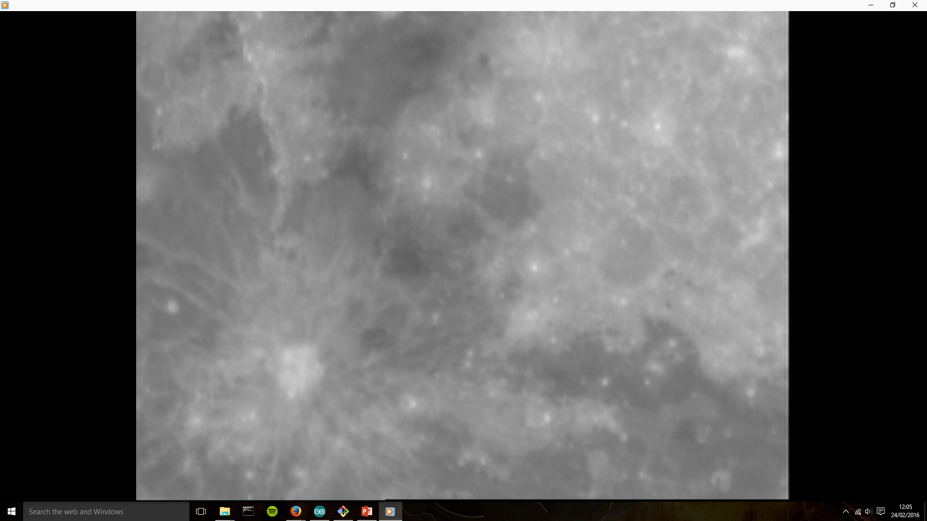
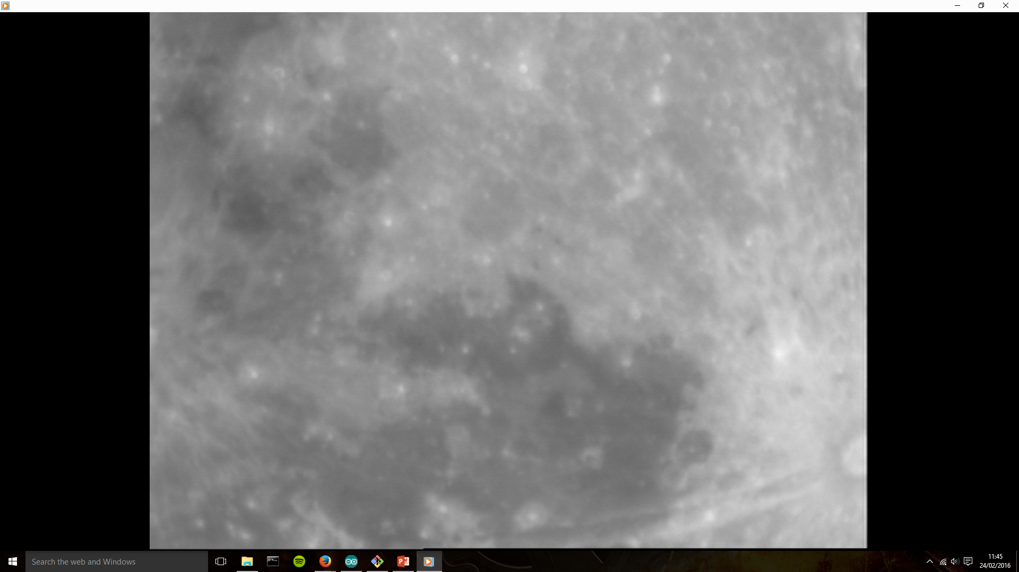
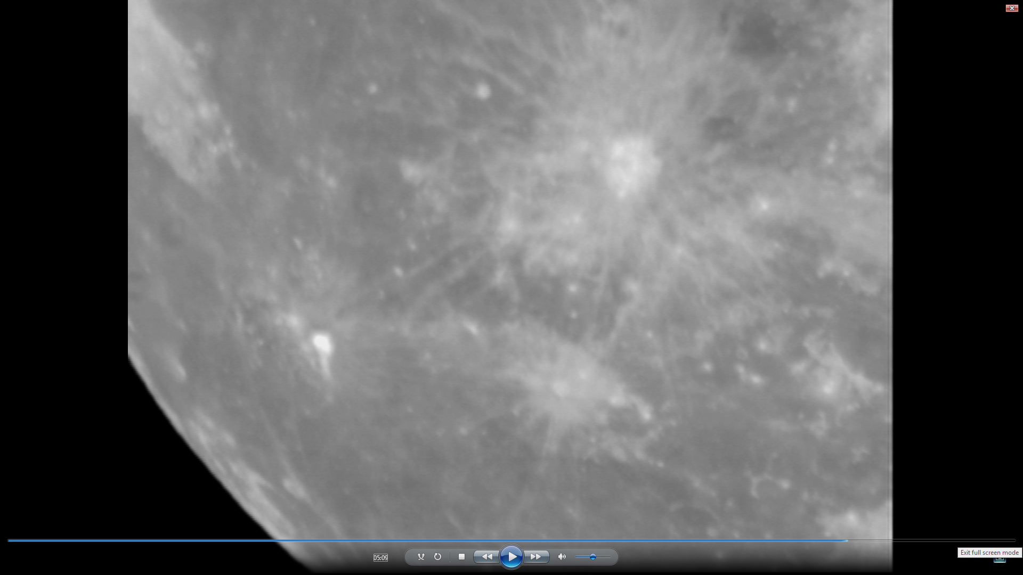
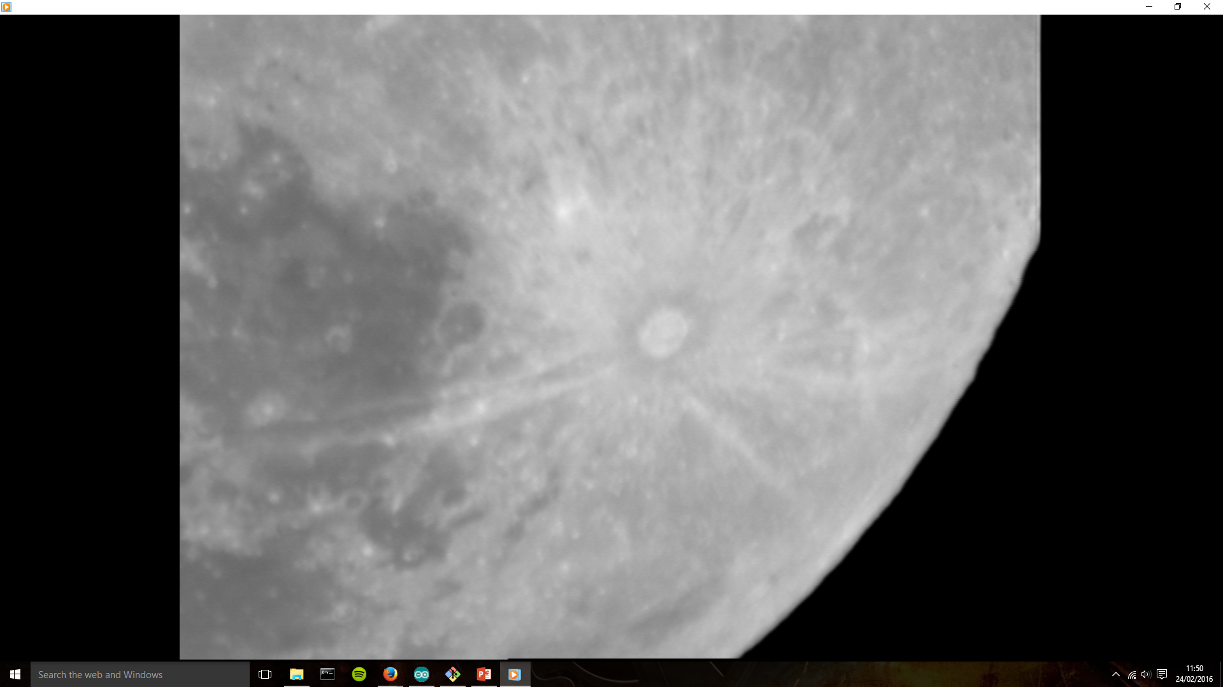
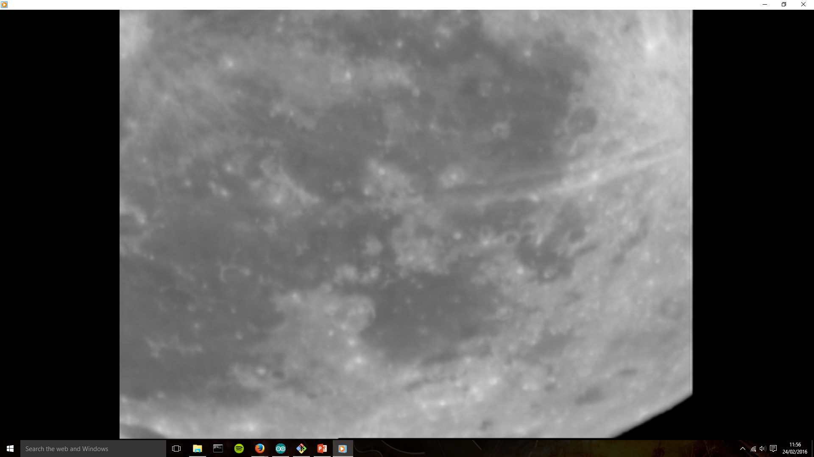
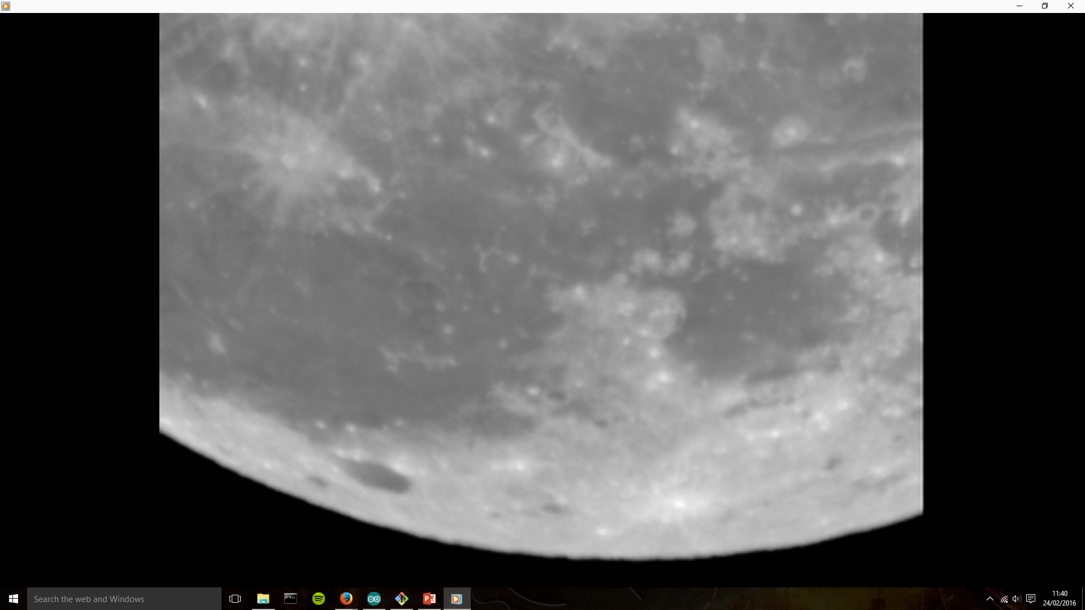
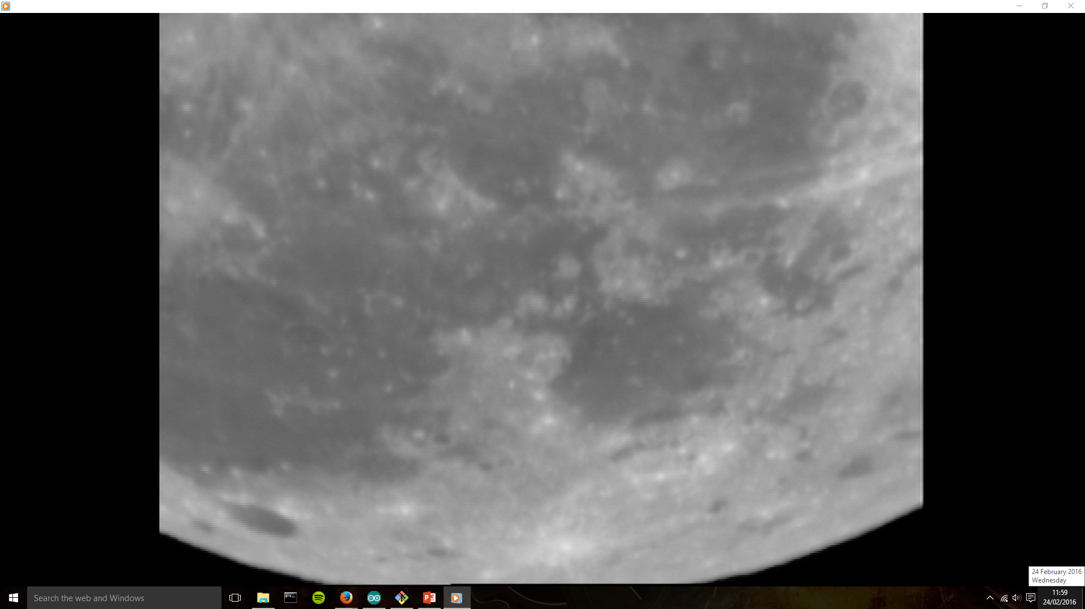
Own images at a different phase

Slide 9
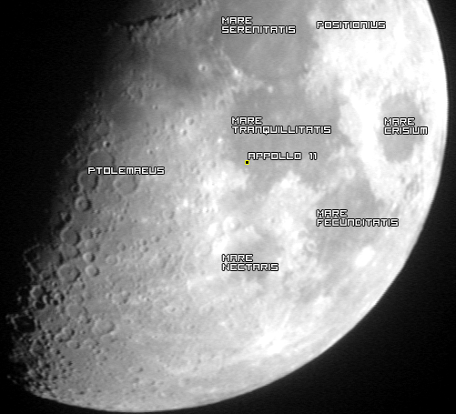
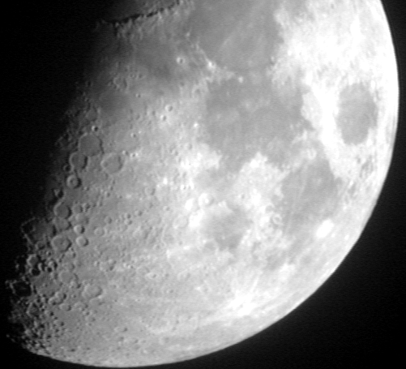
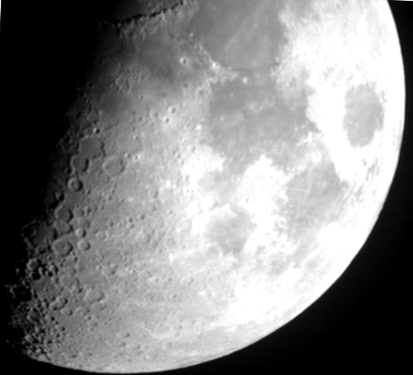
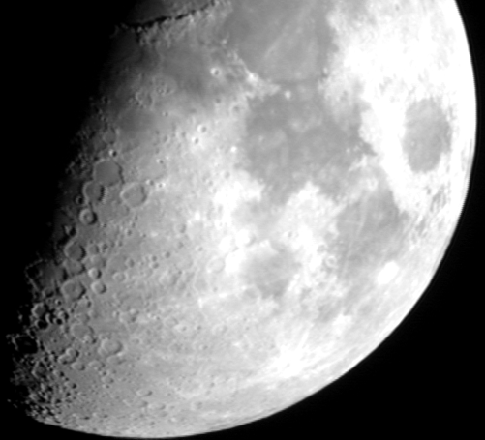
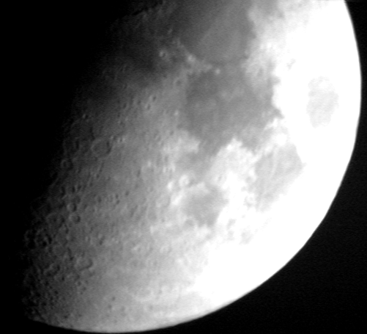
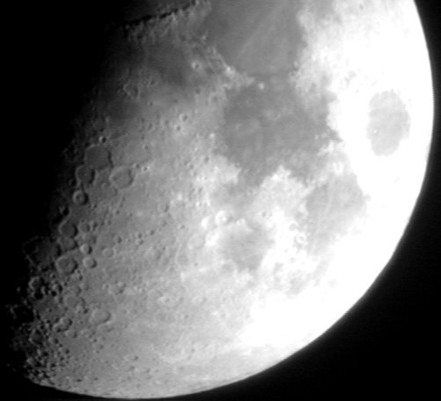
Tony’s Images
436nm
656nm
730nm
855nm
589nm

Slide 10
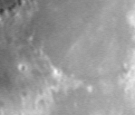
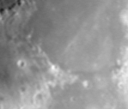
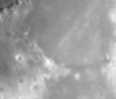
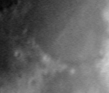
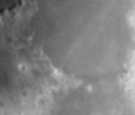
Using Tony’s Images
436nm
589nm
656nm
730nm
855nm
R-Band of Mare Serenitatis, top center of image, and Mare Tranquillitatis, right.

Slide 11
False Colour Imaging
Combining this photo in RGB with Red representing I-band, Green representing R-band and Blue representing B-band yields the following result:

Slide 12
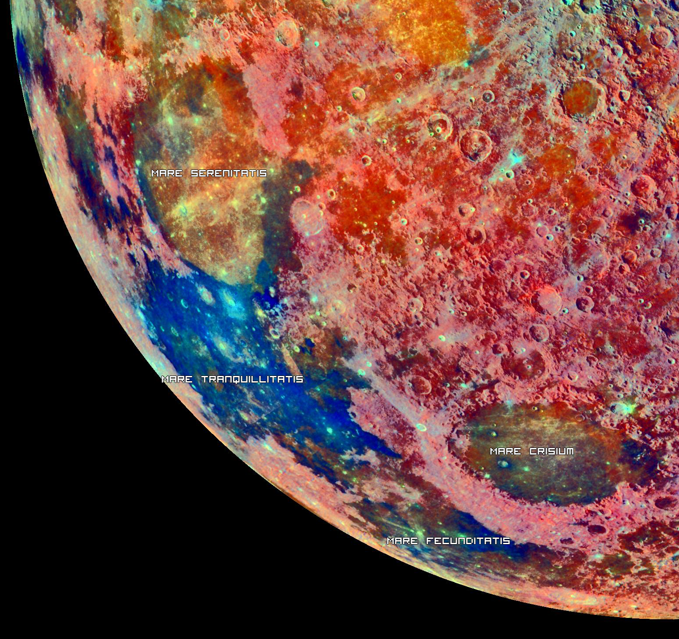
Comparing this to NASAs spectral composition of the moon shows a similar result where Mare Serenitatis is in the green-yellow part of the spectrum and Mare Tranquillitatis is in the blue-purple part.

Slide 14
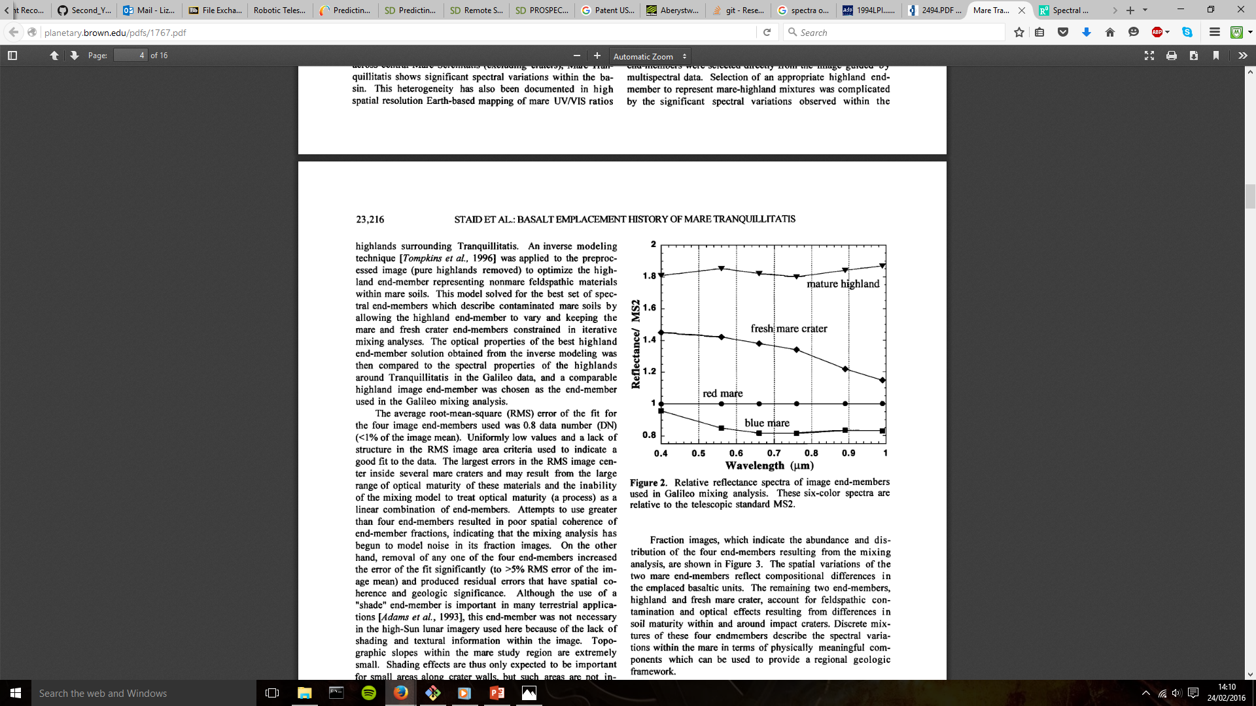
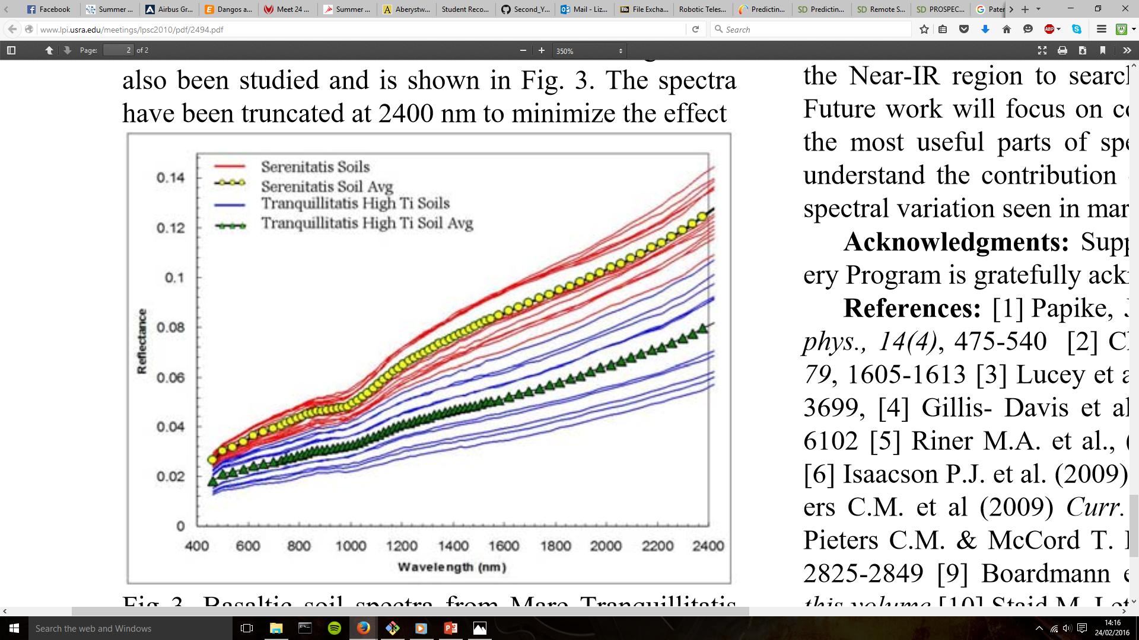
JOURNAL OF GEOPHYSICAL RESEARCH, VOL. 101, NO. El0, PAGES 23,213-23,228, OCTOBER 25, 1996
Mare
Tranquillitatis
Mare
Serenitatis
41stLunarandPlanetaryScienceConference(2010), http://www.lpi.usra.edu/meetings/lpsc2010/pdf/2494.pdf

Slide 15
Comparing Different mare and highland
This is where i want ur stuffs tome, histogram comperson

Slide 16
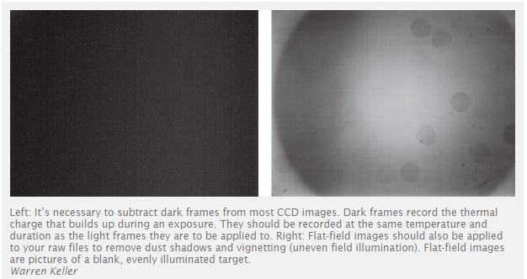
Optical effects:
Vignetting:
Effect that darkens the corners of a picture
(ask tom if noticable when creating moeacs)’
Flat-fiel images
Also removes any dust rings
«Toms picture of Tonys dust rings»

Slide 17
Chromatic Aberration
In a dispersive prism, material dispersion (a wavelength-dependent refractive index) causes different colors to refract at different angles, splitting white light into a rainbow.
Lenses might might have this problem
Worse in higher frequencies
https://en.m.wikipedia.org/wiki/Dispersion_%28optics%29

Slide 18
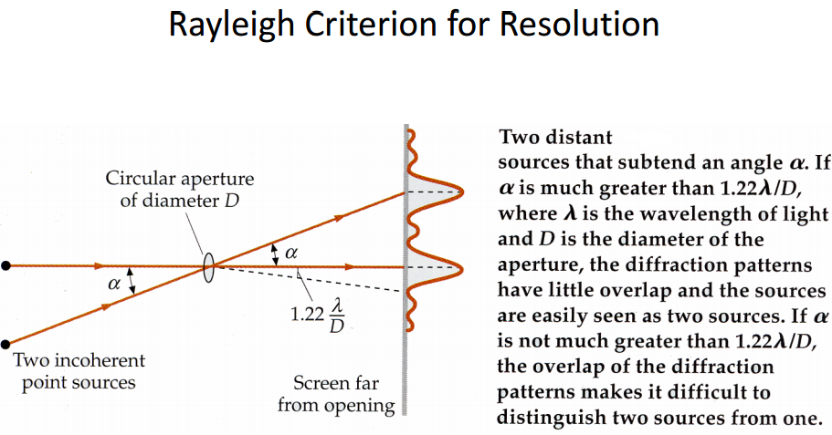
Calibrating and errors on a telescope:
Remember disclaimer to say we have not calibrated our pictures:
(Tom’s pictures and graphs that take into account earth’s atmosphere, as it will effect absorption bands)
(Tom’s curves needs to be added as well)
Need to calibrate the filters of the telescope against something with a known spectrum. We couldn’t have done this as the filters of the telescope does not work. This is the reason why we are supposed to find spectra on line, but we have not found any. Need to calibrate it to take into account that the filters won’t let thru the exact same amount of intensity as each other and ultimately give us reflectivity. Won’t need to calculate total intensity hitting the moon (Tom’s formula).
Mention Tony’s pictures where dust on the lens can clearly be seen.
Optical resolution:

Slide 19
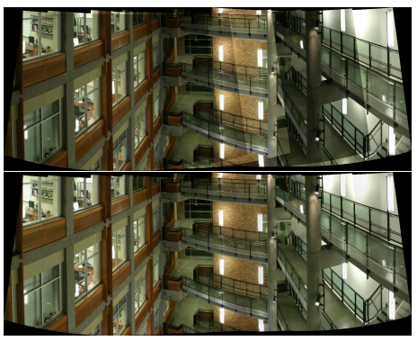
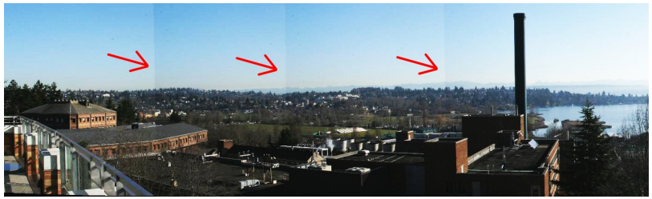
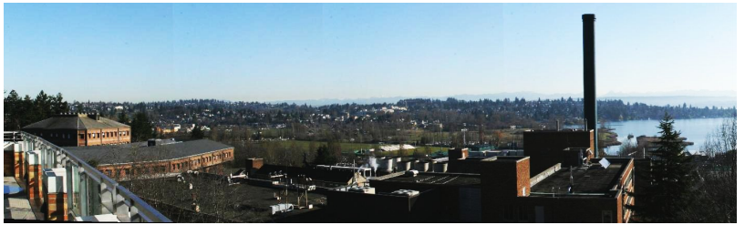
Vignette:
See if we can see examples of vignette in Tony’s pictures when putting them tougher like in example:
Example:

Slide 20
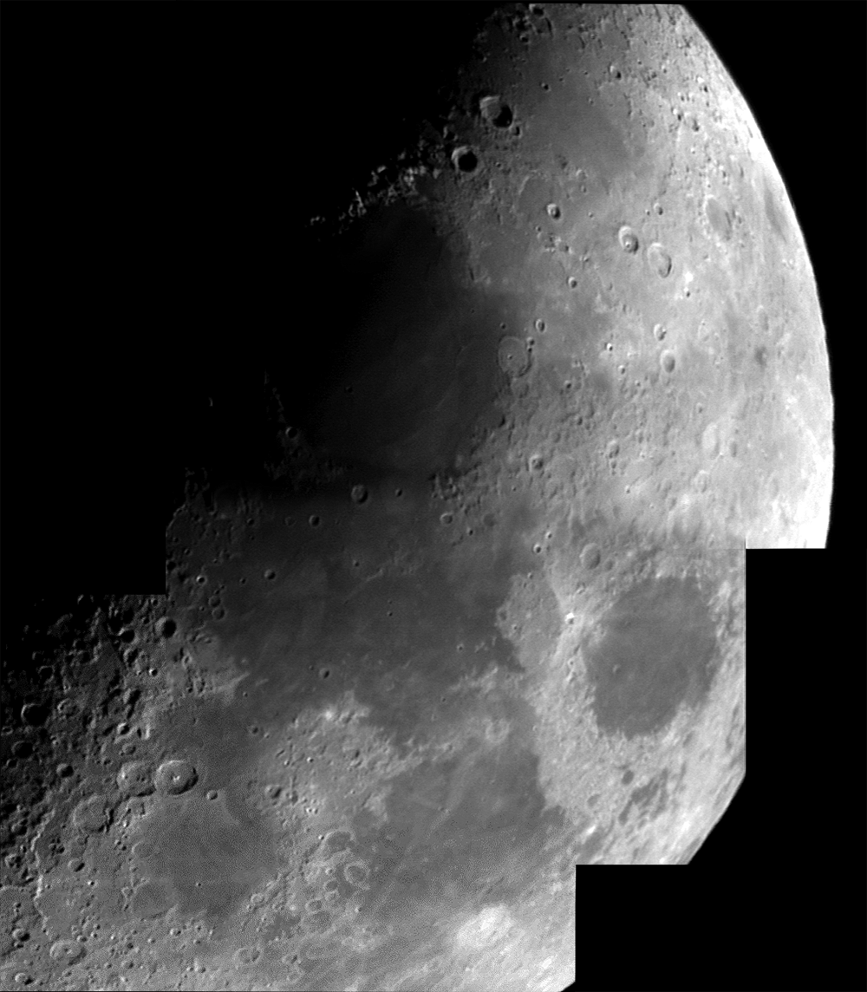
Taking our own images

Slide 21
When taking raw pictures
Remember disclaimer to say we have not calibrated our pictures:
(Tom’s pictures and graphs that take into account earth’s atmosphere, as it will effect absorption bands)
Light pollution also needs to be taken into account(clearer sky)

